Slide 1
Conditional Formatting
Purpose: Highlights cells based on specific conditions.
Examples:
Highlight values > 100
Color top 10% in green
Steps:
1. Select data range
2. Home > Conditional Formatting
3. Choose rule type (e.g., greater than, color scales)

Slide 2
XLOOKUP
XLOOKUP is a modern Excel function used to search for a value in a table and return a matching result from another column.
It replaces:
VLOOKUP
HLOOKUPCan search left or right
No need to count column numbers
Handles errors easily
Works vertically and horizontally

Slide 3
Pivot Tables & Pivot Charts
Purpose: Summarize large datasets.
Pivot Table:
- Rows: Categories (e.g., Department)
- Columns: Years
- Values: Totals (e.g., Sales)
Pivot Chart: Graphical version of a Pivot Table.
Steps:
1. Select data
2. Insert > Pivot Table / Pivot Chart

Slide 4
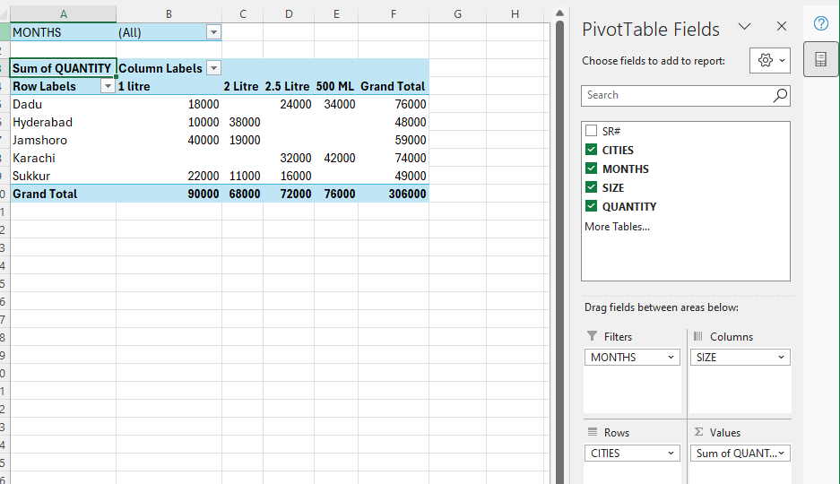
Pivot tables

Slide 5
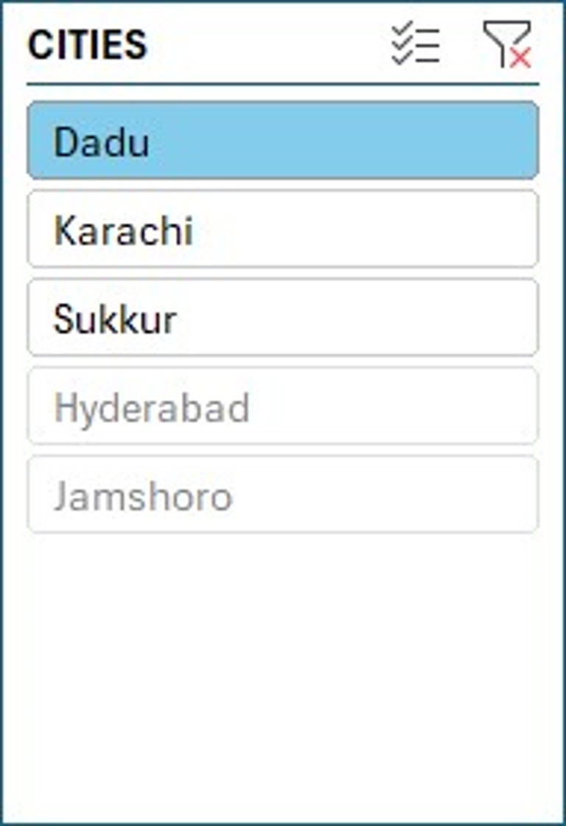
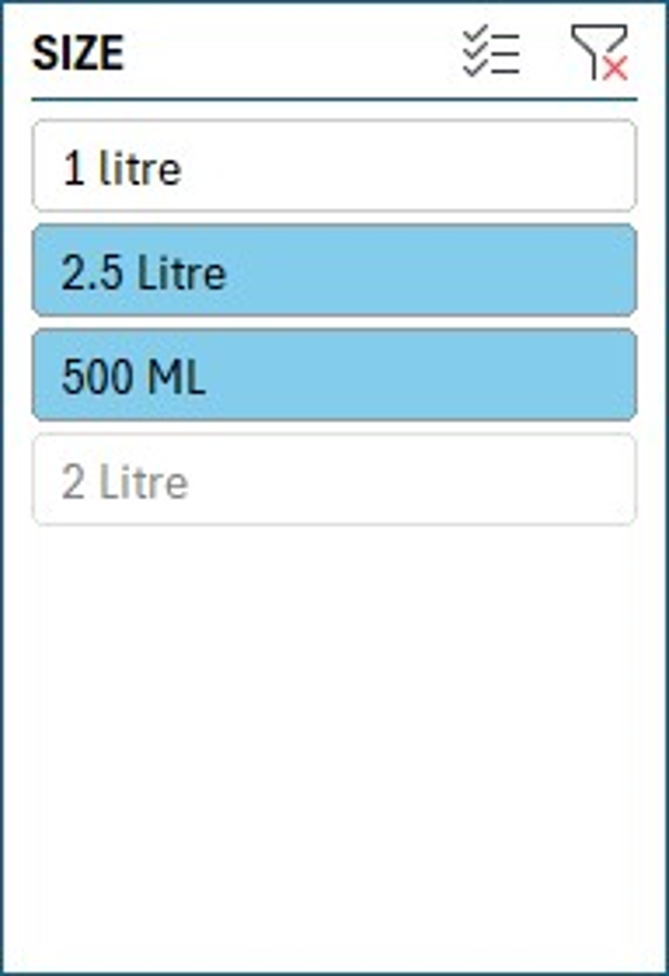
Slicer
Used for filter data
One-click filtering
Easy filtering

Slide 6
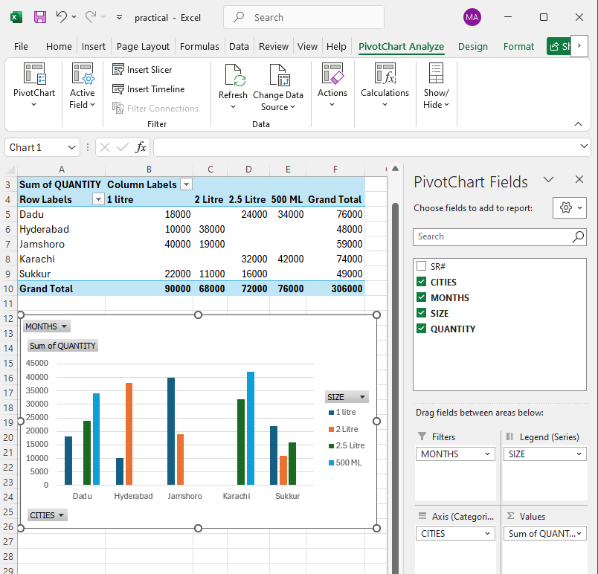
Pivot Charts
PIVOT CHARTS WILL ADD NOT ONLY CHARTS IT WILL ADD TABLES TOO .

Slide 7
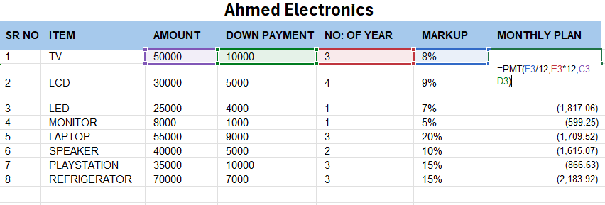
PMT(Payment)

Slide 8
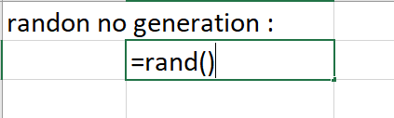
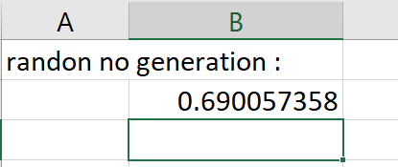
RAND & RANDBETWEEN Formulas
RAND(): Returns a random decimal between 0 and 1
Example: =RAND()
RANDBETWEEN(): Returns a random integer between two values
Example: =RANDBETWEEN(1, 100)

Slide 9
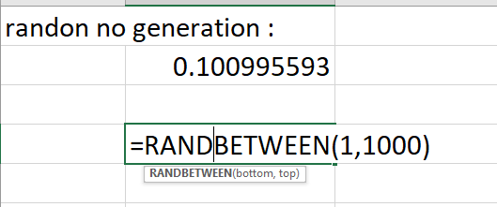
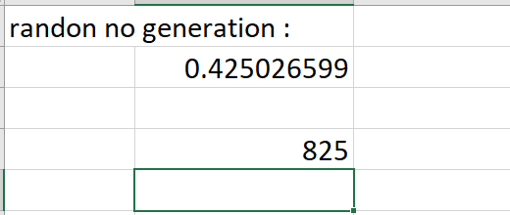

Slide 10
Creating an Attendance Sheet
Components:
- Column A: Names
- Row 1: Dates
- Cells: P = Present, A = Absent, L = Late
Tips:
- Use Data Validation to restrict input to P, A, L
- Use COUNTIF to calculate attendance:
=COUNTIF(B2:Z2, "P")

Slide 11
